Slide 1
Agenda
Wegmans activity
Motivation
Case study homework due Wednesday

Slide 2
Motivation
What motivates you?
Where does it come from?

Slide 3
The Motivation Process
Motivation is defined as forces from within individuals that stimulate and drive them to achieve goals.
Notes:
We define motivation as forces from within individuals that stimulate and drive them to achieve goals. But how does motivation affect the way we behave? Motivation is a process by which behavior is energized, meaning we are willing to work hard; directed, meaning we have chosen what to work at; and maintained, meaning we intend to work for some period of time to achieve objectives.

Slide 4
Intrinsic Motivation
Intrinsic Motivation
need for competence
need for self-determination
Notes:
There are two main mechanisms of intrinsic motivation: need for competence, and need for self-determination. In carrying out her duties as assistant manager, Katie is satisfying her need for competence, which is the satisfaction we gain by stretching and exercising our capabilities, and her need for self-determination, or the feeling of satisfaction and control we get from making efforts that do not rely on any external influences.

Slide 5
Types of Extrinsic Rewards
Extrinsic rewards are external awards to employees such as salary, bonuses, and paid vacations.
Notes:
Extrinsic rewards are external awards to employees such as salary, bonuses, and paid vacations. Extrinsic rewards can either increase intrinsic motivation, if the rewards are high, or decrease it if they are low. On the one hand, extrinsic rewards act as a source of competency information. That is, by directly and concretely showing the employee he or she is valued through financial rewards, for example, they increase feelings of competence and self-determination and therefore increase intrinsic motivation. On the other hand, when people feel they are being under-rewarded, their feelings of self-determination decrease, as does their intrinsic motivation.²

Slide 6
What is Motivation?
Forces that initiate work-related effort.
  Determine direction, intensity, and persistence of the effort.
  Originates within and outside an employee.
  Is critical because performance is a function of motivation and ability.

Slide 7
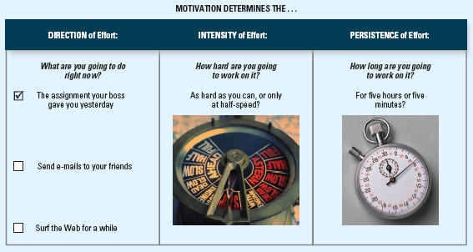
Motivation and Effort

Slide 8
Expectancy Theory
Describes employees’ cognitive processes in choosing among voluntary responses.
  Based on the idea that behavior is directed toward pleasure and away from pain.

Slide 9
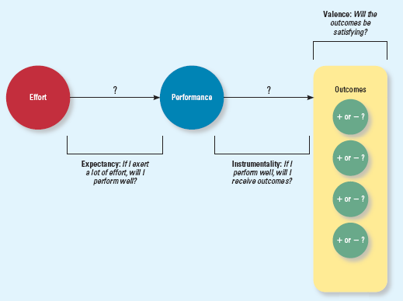
Expectancy Theory

Slide 10
Expectancy Theory, Cont’d
Expectancy - belief that a high level of effort will result in successful performance (E → P).
  Is influenced by self-efficacy (belief that you have the capabilities needed).
    Based on:
      Past accomplishments
      Vicarious experiences
      Verbal persuasion
      Emotional cues

Slide 11
Expectancy Theory in Action

Slide 12
Goal Setting Theory
Views goals as the primary drivers of the intensity and persistence of effort.
  Assigning specific and difficult goals results in higher performance
Theory in action: Management by objectives/SMART(ER) goals

Slide 13
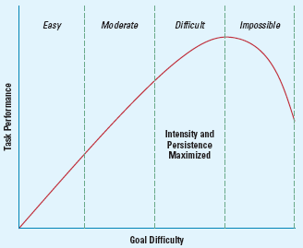
Goal Difficulty and Task Performance
What is a difficult goal?

Slide 14
Learned Needs Theory
Needs can be “learned” -- strengthened through reinforcement, learning, and social conditions
Three learned needs studied by McClelland
  Need for achievement -- reach goals, take responsibility
  Need for affiliation -- seek approval, avoid conflict
  Need for power – control one’s environment
Successful entrepreneurs tend to have a high nAch
Successful leaders tend to have relatively low nAff and relatively high socialized nPow
5-14

Slide 15
Equity Theory
Suggests motivation depends on what happens to other people.
  Employees create a “mental ledger” of their outcomes and inputs.
  Employees compare their outcomes-to-inputs ratio to the ratio of a comparison other.
    Referred to as “Cognitive calculus.”

Slide 16
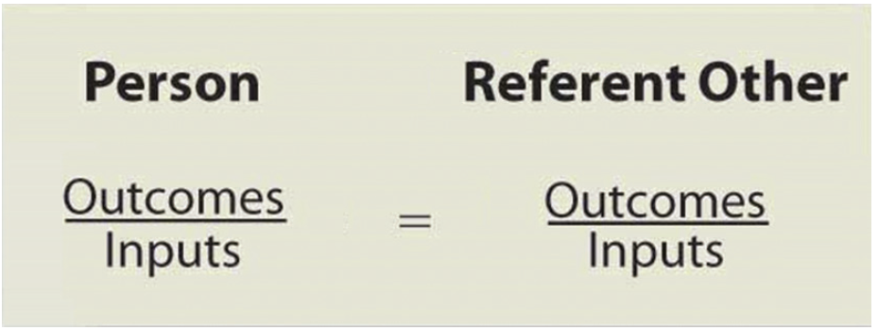
Figure 5.5: Equity Theory
Equity Theory
Equity theory says we perceive the fairness of rewards as a ratio of input to outcome and compare our ratio to other people’s.
Notes:
People tend to compare their own perceived I/O ratio to their perceptions of the I/O ratio of referent others, or people whose situation is comparable to their own. As long as the ratios are similar there is no problem, but someone who perceives the other person’s ratio as greater than his or her own will feel an inequity. For example, Diego believes he is under-rewarded because he is getting lower tips than the other servers, which he thinks is unfair. People adopt several behaviors in the face of such perceived inequity.

Slide 17
Equity Theory, Cont’d
Outcomes of “cognitive calculus”:
    Your ratio is equal to your comparison other’s.
    Your ratio is less than your comparison other’s.
      Increase your outcomes; decrease your inputs
    Your ratio is greater than your comparison other’s
      Decrease your outcomes; increase your inputs

Slide 18
Dimensions of Justice
Distributive justice
Procedural justice

Slide 19
Distributive Justice
Perceived fairness of decision-making outcomes.
  Employees decide if outcomes (e.g., pay, rewards, and promotions) are allocated fairly (e.g., using equity norms).

Slide 20
Procedural Justice
Perceived fairness of decision-making processes.
  Fostered when authorities adhere to Procedural Justice Rules:
    Voice – giving a chance to express opinions.
    Correctability – giving a chance to request an appeal.
    Consistency, bias suppression, representativeness, and accuracy - help ensure procedures are objective.

Slide 21
Distributive Justice and
Procedural Justice
Does procedural justice really matter—don’t people just care about the outcomes they receive?
Distributive justice and procedural justice combine to influence employee reactions.
  When outcomes are bad, PJ becomes important.
  PJ tends to be a stronger driver of reactions than DJ.

Slide 22
Motivation through Job Design
Job design is a method of setting forth the duties and responsibilities of a job with the intention of improving productivity and performance.
Notes:
Job design is a method of setting forth the duties and responsibilities of a job with the intention of improving productivity and performance.

Slide 23
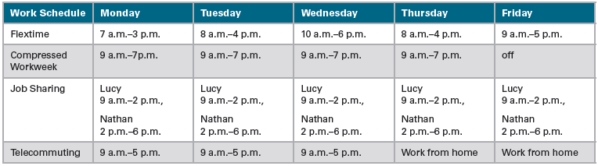
Figure 6.4: Examples of Nontraditional Work Schedules
Nontraditional Work Schedules
Notes:
These are the four main nontraditional work schedules commonly adopted by employers in today’s workplace:
Flextime means flexible working hours whereby an employee can customize his or her own work hours within limits established by management. For example, an employee might work a 7:00 am to 3:00 pm shift rather than the more traditional 9:00 am to 5:00 pm workday.
Compressed workweeks gives employees the benefit of an extra day off by allowing them to work their usual number of hours in fewer days per pay period. For example, the employee might work four 10-hour days each week and then enjoy a three-day weekend, or work 80 hours in nine days with an extra day off every other week.
Job sharing divides one full-time job among two or more people who work pre-determined hours. Job sharers can hand over their work to the next person when their part of the shift ends and the next begins.
Telecommuting means working from home or from a remote location on a computer or other advanced telecommunications system linked to the main office. This gives workers greater flexibility in terms of working hours and location. Yahoo CEO Marissa Mayer sparked much debate in 2013 for reversing the company’s policy and banning telecommuting, going against the trend seen often in the tech industry.²⁸

Slide 24
Wednesday
Case study write-up due

